Slide 1
Object-Oriented Programming
Mohammad Salman
Dean’s Fellow

Slide 2
Some insights from the lab
An object gets implicitly passed to the function that is called through that object.
TollBooth t1;
t1.show();// compiler sees this as, TollBooth::show(&t1)

Slide 3
Some insights from the lab
Within TollBooth::show(), you can access t1’s attributes just by writing out the names of the attributes.
void TollBooth::show() const
{
std::cout << cars << ‘ ‘ << money << ‘\n’;
}
These are referring to t1’s attributes (or whatever the calling object will be).

Slide 4
Some insights from the lab
Similarly, observe the following.
Complex c1{1, 9};
Complex c2{-4, 10.2};
c1.add(c2); // compiler reads, Complex::add(&c1, c2)

Slide 5
Some insights from the lab
c1.add(c2);
Within Complex::add(), this is how you can access attributes of c1 and c2.
Complex Complex::add(const Complex& c2)
{
c2.real; c2.imag; // c2’s attributes
real; imag; // c1’s attributes
}

Slide 6
Some insights from the lab
c1.add(c2);
With this example, also note the following.
c1
c2
real | imag
add() subtract() multiply() …
real | imag
add() subtract() multiply() …
Accessing c2’s attributes in c1’s function call works because access specifiers work on a per-class basis (c1 and c2 belong to the same class, so this works).
Keep in mind that real and imag are private members of class Complex.

Slide 7
Copy Constructors
Patch Notes for this section
Updated the implementation for the user-defined copy ctor (slide 20).
The array elements of list1 are copied into the array elements of list2 (which was initialized using the copy ctor) within the body of the copy ctor.
Added new slides.
Creating new objects using existing ones
https://www.learncpp.com/cpp-tutorial/introduction-to-the-copy-constructor/

Slide 8
In the first line, f has been initialized using the provided parameters.
In the second line, a new object is created (fCopy) using an existing object of the same class (f).
Our ctor’s parameters are not suited for this.
Yet, this program will work just fine!
class Fraction
{
private:
int m_num;
int m_den;
public:
Fraction(int num, int den)
: m_num{ num }, m_den{ den }
{
}
void print() const
{
std::cout << "Fraction(" << m_num << ", "
<< m_den << ")\n";
}
};
int main()
{
// Calls Fraction(int, int) constructor
Fraction f { 5, 3 };
// What constructor is used here?
Fraction fCopy { f };
f.print();
fCopy.print();
return 0;
}
Notes:
Can I initialize an object of this class with zero parameters?
Can I initialize an object of this class one parameter?

Slide 9
What is a Copy Constructor?
Copy constructor is a constructor that is used to initialize an object with an existing object of the same type.
The newly created object will be a copy of the object passed in as the initializer.
If you do not provide a copy constructor for your classes, the compiler will provide a public implicit copy constructor for you.

Slide 10
fCopy’s attributes will be initialized using the values of the attributes of f.
Note that the data of both objects is still independent from one another.
Changing f’s attributes will not impact fCopy’s attributes and vice versa.
Fraction f
Fraction fCopy
m_num = 5 | m_den = 3
void print() const
m_num = 5 | m_den = 3
void print() const

Slide 11
This is what a copy ctor looks like.
Take note of the parameter that the copy ctor is accepting.
class Fraction
{
private:
int m_num;
int m_den;
public:
Fraction(int num, int den)
: m_num{num}, m_den{den}
{
} // Copy constructor
Fraction(const Fraction& frac)
: m_num{ frac.m_num }, m_den{ frac.m_den }
{
// just to prove it works
std::cout << "Copy constructor called\n";
} };
int main()
{
// Calls the regular constructor
Fraction f { 5, 3 };
// Calls copy constructor
Fraction fCopy { f };
return 0;
}
This is an application of “Access controls work on a per-class basis”.
Notes:
Can I access m_num and m_den of the implicit object; they’re private right now?
Can I access frac’s attributes like I am; they’re private btw? Why will it work?

Slide 12
Where else would a copy constructor be used?
Another situation where copy ctors would be called will be when you pass objects by value to some function.
Pass by value means that copies of the passed parameters are created.
If your parameter is an object, then its copy will be created.
And for its copy to be created, the copy ctor will be called.

Slide 13
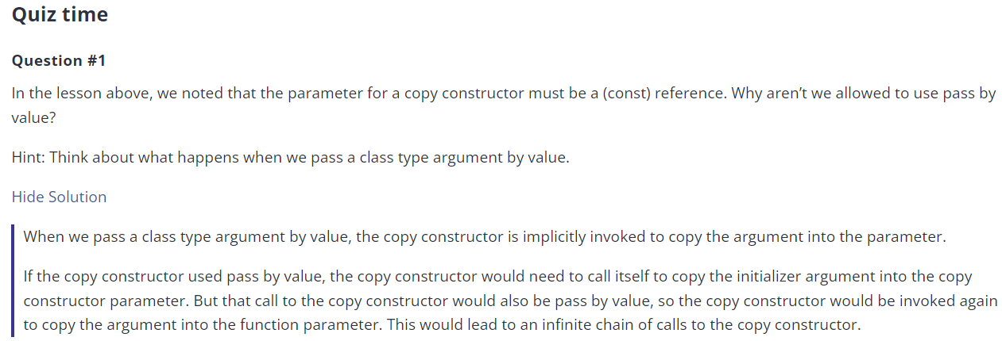
https://www.learncpp.com/cpp-tutorial/introduction-to-the-copy-constructor/

Slide 14
Question
Do you think that you could pass the object by value in the copy ctor?
// Calls the regular constructor
Fraction f { 5, 3 };
// Calls copy constructor
Fraction fCopy { f };
// Pass by value
Fraction(Fraction frac)
: m_num{ frac.m_num }, m_den{ frac.m_den }
{
}
Not OK
Compiler error
// Pass by value; the copy cannot is const
Fraction(const Fraction frac)
: m_num{ frac.m_num }, m_den{ frac.m_den }
{
}
Not OK
Compiler error
// Pass by reference
Fraction(Fraction& frac)
: m_num{ frac.m_num }, m_den{ frac.m_den }
{
}
OK (but const is better)

Slide 15
Why would you ever need to write your own copy constructor though?
Patch Notes for this section
Updated some information.
Similar reason as when you would need to write your own destructor…
Precursor to the RULE OF THREE

Slide 16
At the moment, the default copy ctor will be used.
Attributes of list1 will be copied over to attributes of list2.
What will this result in?
class MyList
{
private:
double* m_array;
int m_length;
public:
int getLength() const { return m_length; }
MyList(int length)
: m_array{ new double[length]{} },
m_length{ length }
{}
~MyList()
{
delete[] m_array;
}
};
int main()
{
MyList list1{ 5 };
if(true)
{
MyList list2{ list1 };
}
return 0;
}

Slide 17



At the moment, the implicit copy ctor will be used.
Attributes of list1 will be copied over to attributes of list2.
What will this result in?
Stack Memory
Automatic Memory Allocation
Heap Memory
Dynamic Memory Allocation
double* = 0x90 | int = 5
Methods
0.0 | 0.0 | 0.0 | 0.0 | 0.0
list1
0x20
0x90
double* = 0x90 | int = 5
Methods
list2
This is known as a shallow copy.
0x50

Slide 18
What will happen to the dynamic array when list2 goes out of scope?
That array will be deallocated because of the call to the dtor for list2.
list1’s pointer attribute will be left dangling.
class MyList
{
private:
double* m_array;
int m_length;
public:
int getLength() const { return m_length; }
MyList(int length)
: m_array{ new double[length]{} },
m_length{ length }
{}
~MyList()
{
delete[] m_array;
}
};
int main()
{
MyList list1{ 5 };
if(true)
{
MyList list2{ list1 };
}
return 0;
}

Slide 19
As list2 is about to go out of scope, the compiler triggers a call to the dtor for list2.
The array on the heap gets deallocated in the dtor call for list2.
But list1’s pointer attribute is left dangling.
Exit animations are enabled on this slide
Stack Memory
Automatic Memory Allocation
Heap Memory
Dynamic Memory Allocation
double* = 0x90 | int = 5
Methods
0.0 | 0.0 | 0.0 | 0.0 | 0.0
list1
0x20
0x90
double* = 0x90 | int = 5
Methods
list2
0x50

Slide 20
This is a good situation to write your own copy ctor.
Here, you allocate separate memory on the heap for the copy object.
Recall that in these type of situations, you should write your own dtor and your own copy ctor.
There is a third thing that you should also write, which we’ll see later in operator overloading.
RULE OF THREE
// Within the class
MyList(const MyList& ob)
: m_array{ new double[ob.m_length] },
m_length{ ob.m_length }
{
for(int i{}; i < ob.m_length; i++)
{
m_array[i] = ob.m_array[i];
}
}
class MyList
{
private:
double* m_array;
int m_length;
public:
int getLength() const { return m_length; }
MyList(int length)
: m_array{ new double[length]{} },
m_length{ length }
{}
~MyList()
{
delete[] m_array;
}
};
I am copying the elements in the array associated with list1 to the array associated with list2 within the copy ctor’s body.
This is known as a deep copy.

Slide 21
Something to keep in mind…
We mentioned that if we don’t write any ctor (regular and copy), the compiler provides us with a default regular ctor and an implicit copy ctor.
If we write a regular ctor, but do not write a copy ctor, then the compiler doesn’t provide a regular default ctor, but it will provide an implicit copy ctor.
However, if you don’t write a regular ctor, but you do write a copy ctor, then the compiler will not provide you with an implicit copy ctor, but it will also not provide you with a regular default ctor.

Slide 22
Something to keep in mind…
Have I written a regular ctor (default or otherwise)? | Have I written a copy ctor? | What will the compiler provide me with?
No | No | Regular default and copy ctors
Yes | No | Implicit copy ctor
Yes | Yes | Nothing
No | Yes | Nothing
Note that this table is just focusing on these two types of constructors.
We are not talking about other things that the compiler provides us with.

Slide 23
Some Questions…
Patch Notes for this section
Added new slides.
Let’s go back to Fractions and mess around with access levels of constructors…

Slide 24
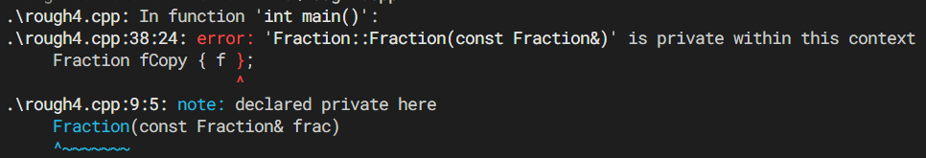
What if I set my copy ctor to private?
Error! Since you wrote your own copy ctor, the compiler doesn’t provide you with one.
Your own copy ctor is private. So how can it be called from main().
class Fraction
{
private:
int m_num;
int m_den;
// Copy constructor
Fraction(const Fraction& frac)
: m_num{ frac.m_num },
m_den{ frac.m_den }
{
}
public:
Fraction(int num, int den)
: m_num{num}, m_den{den}
{
} };
int main()
{
// Calls the regular constructor
Fraction f { 5, 3 };
// Calls copy constructor
Fraction fCopy { f };
return 0;
}

Slide 25
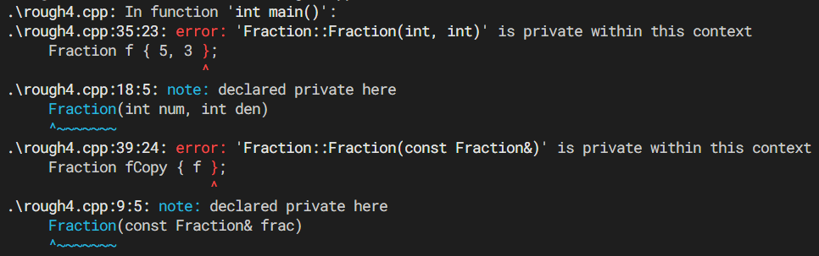
What if I set my regular ctor to private?
Error! Since you wrote your own ctor, the compiler doesn’t provide you with one.
Your own ctor is private. So how can it be called from main().
class Fraction
{
private:
int m_num;
int m_den;
// Copy constructor
Fraction(const Fraction& frac)
: m_num{ frac.m_num },
m_den{ frac.m_den }
{
}
Fraction(int num, int den)
: m_num{num}, m_den{den}
{
}
public:
};
int main()
{
// Calls the regular constructor
Fraction f { 5, 3 };
// Calls copy constructor
Fraction fCopy { f };
return 0;
}

Slide 26
Will this array creation work?
Error! This array is meant to initialize an array of Fractions. That means each element will be a Fraction-type object.
Your ctor, works with two parameters. So each object in the array should be initialized with two parameters.
You are not doing that…
int main()
{
Fraction f{1000, 333};
f.show();
Fraction fArr[3]; for(int i{}; i<3; i++)
{
fArr[i].show();
}
return 0;
}
class Fraction
{
private:
int m_num;
int m_den;
public:
Fraction(int num, int den)
: m_num{num},
m_den{den}
{}
void show() const
{
std::cout << m_num << '/' << m_den << '\n';
}
};

Slide 27
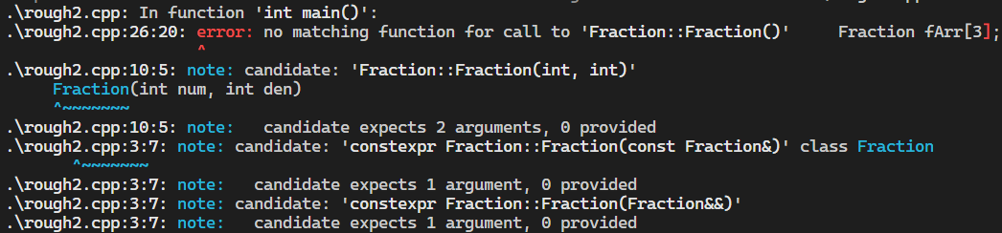
Will this array creation work?
Error! This array is meant to initialize an array of Fractions. That means each element will be a Fraction-type object.
Your ctor, works with two parameters. So each object in the array should be initialized with two parameters.
You are not doing that…
Notes:
It’s like you’re creating three stand along Fraction objects w/o specifying any parameters.

Slide 28

So now you’re initializing each Fraction object so that the ctor could be properly called for each of the Fraction being created.
You can actually add a print statement within the ctor to see.
Another option could be to create a default ctor (zero parameters) so that arrays could be created w/o init values.
int main()
{
Fraction f{1000, 333};
f.show();
Fraction fArr[3]{ {1, 1}, {1, 2}, {1, 4} }; for(int i{}; i<3; i++)
{
fArr[i].show();
}
return 0;
}
class Fraction
{
private:
int m_num;
int m_den;
public:
Fraction(int num, int den)
: m_num{num},
m_den{den}
{ std::cout << "My ctor\n"; }
void show() const
{
std::cout << m_num << '/' << m_den << '\n';
}
};

Slide 29
Self Study. In case of errors, fix them. Also, determine the output of this program.
class Fraction
{
private:
int m_num;
int m_den;
public:
Fraction(int num, int den)
: m_num{num},
m_den{den}
{ std::cout << "My ctor\n"; }
~Fraction() { std::cout << "My dtor\n"; }
void show() const
{
std::cout << m_num << '/' << m_den << '\n';
}
};
int main()
{
Fraction* fArr{ new Fraction[3] };
for(int i{}; i<3; i++)
{
fArr[i].show();
}
delete[] fArr;
return 0;
}

